Slide 1

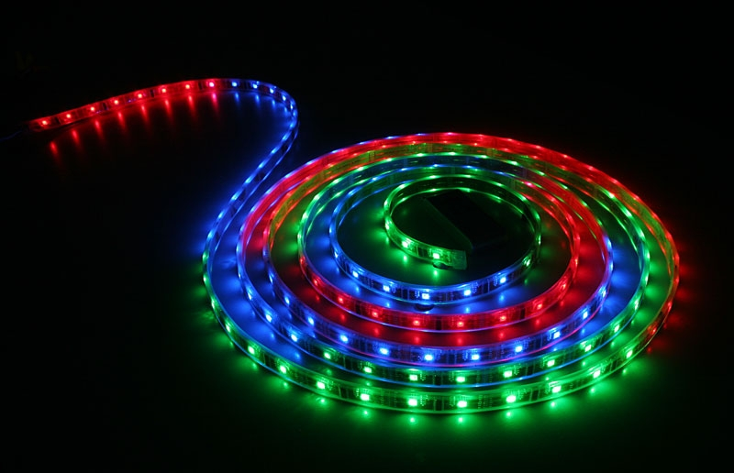
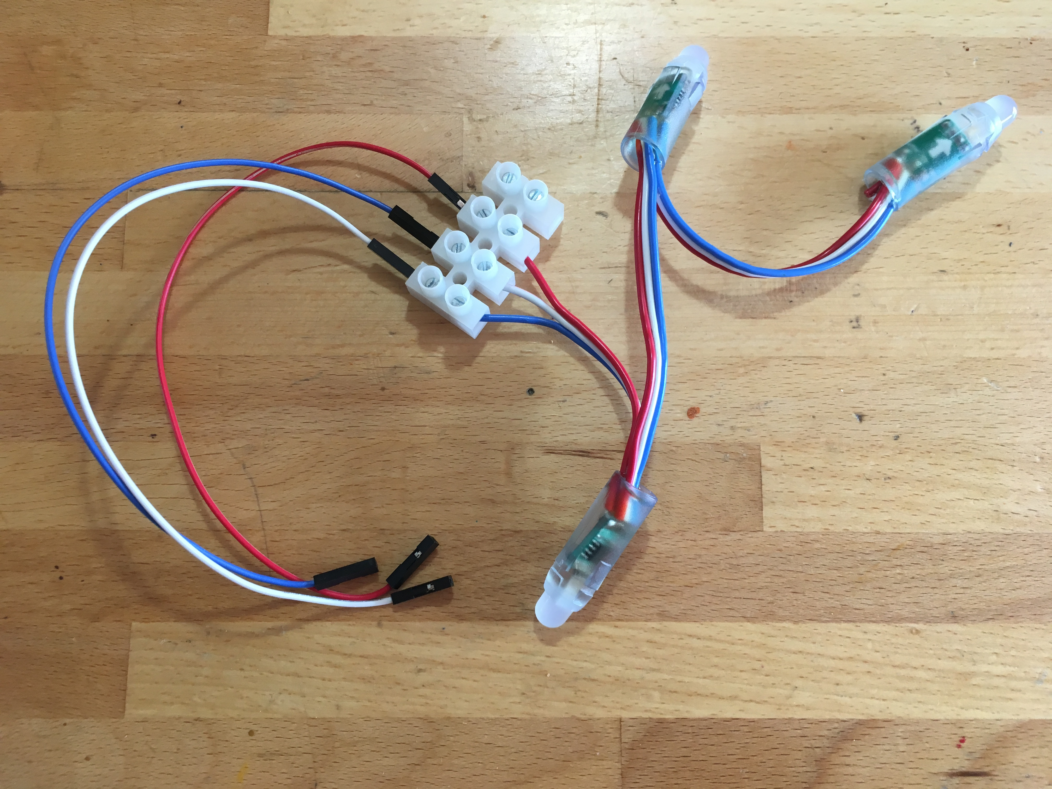
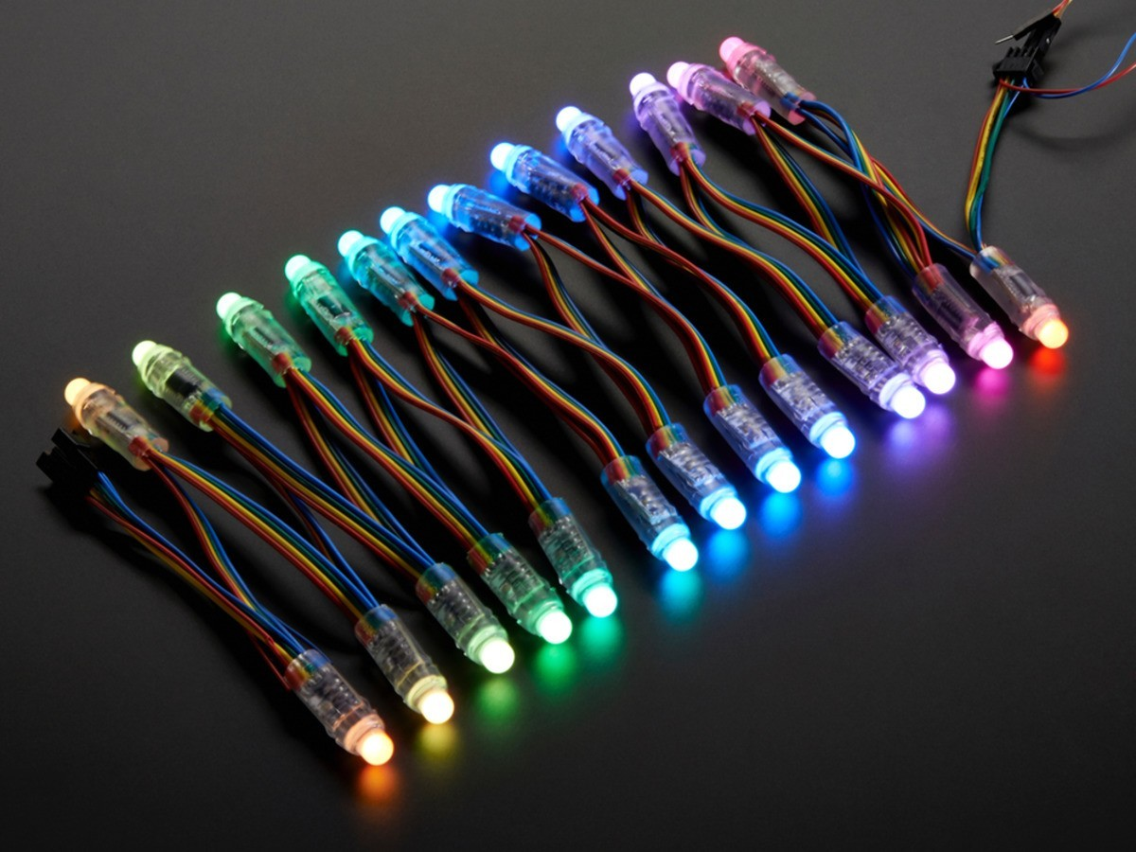
Raspberry Pi Individually Addressable LEDs
Cotswold Raspberry Jam
Saturday 2nd March 2019

Slide 2
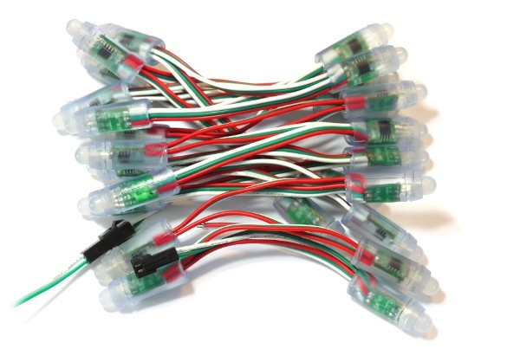
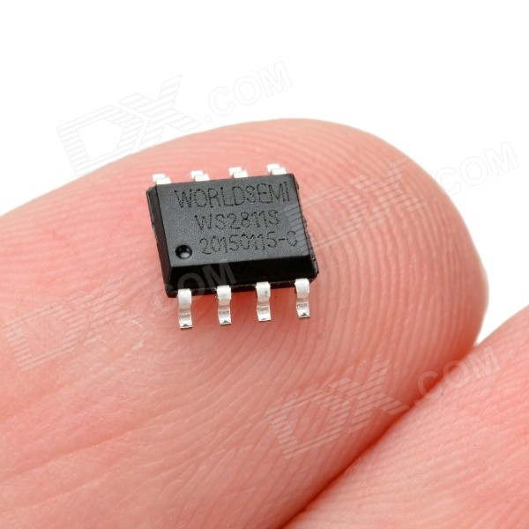
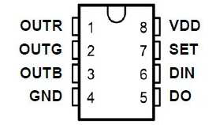
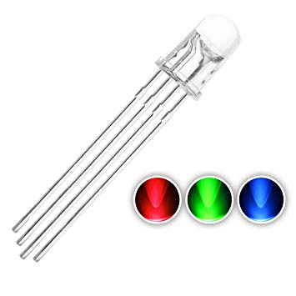
ws2811

Slide 3
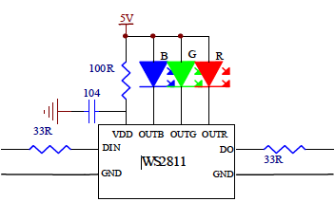
RGB
Each LED is actually 3
RED
GREEN
BLUE
Individually set each R G B to brightness between 0 and 255
Each colour takes 8 bits
Each LED (3 colours) takes 3 x 8 bits = 24 bits

Slide 4
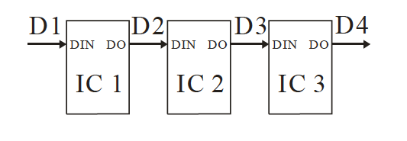
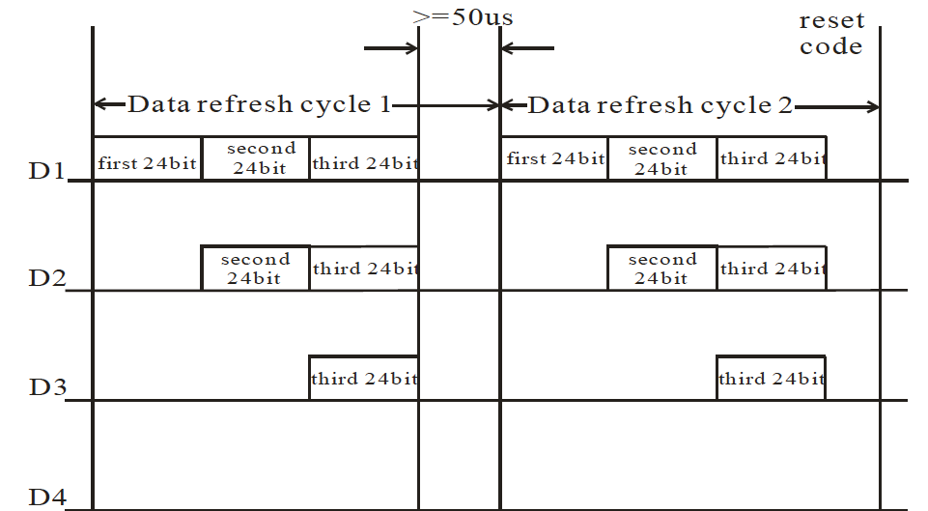

Slide 5
PLEASE
Make sure the Pi is turned off before you start wiring
And
Get your wiring checked before you turn the Pi on

